Slide 1
Rethinking the Library OS from the Top Down
Donald E. Porter,
Silas Boyd-Wickizer ,
Jon Howell,
Reuben Olinsky,
Galen C. Hunt
Presented by:- Benjamin Paul , TTU

Slide 2
Contents
Introduction and backstory
Problems with VMM
Drawbridge
Results
Conclusion

Slide 3
Introduction and Backstory
Paper is published in 2011.
The paper is based on windows 7 refactored LibOS called Drawbridge
Windows wanted to create its own container for business purposes
By 2013 docker was made available and started becoming popular
It gained supported by GOOGLE , IBM , RedHat, Vmware.
NOTE : Docker was initially based on LINUX underlying OS.

Slide 4
Motive
To refactor a commercial OS to follow LibOS architecture and to achieve better performance than VM
VMs are great for isolation, but have significant overheads such as :-
  Resource Overheads: disk (GBs) and memory (512 MB+) per VM .
  Runtime Overheads: CPU virtualization, I/O virtualization, etc.
  Administrative Overheads: one new OS to manage per VM .
  Ingress/Egress Overheads: moving large VHDs to/from the cloud

Slide 5
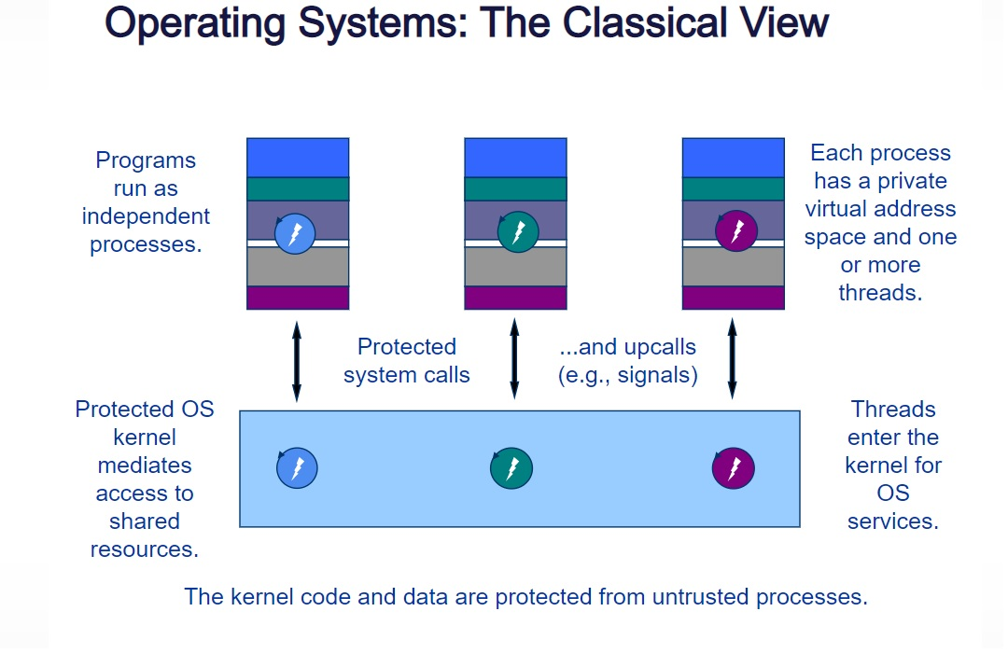
Classical OS model

Slide 6
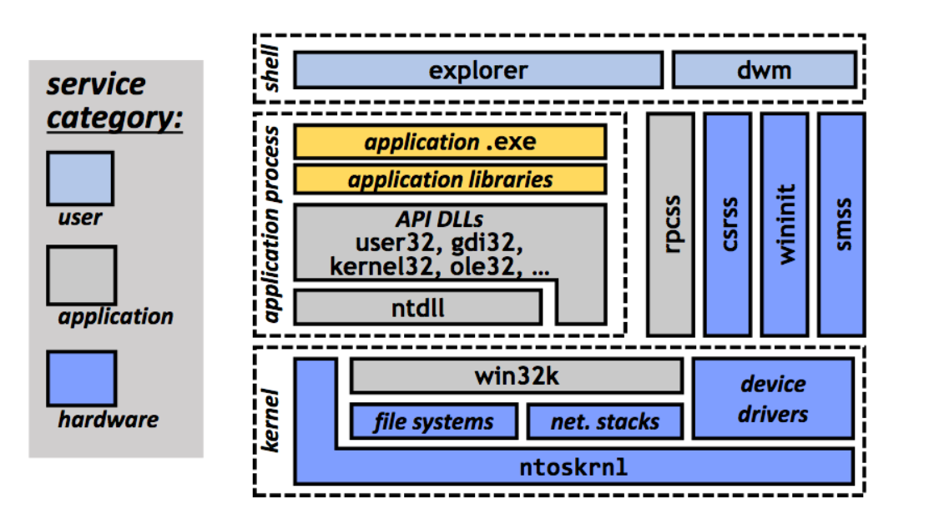
Windows 7 OS architecture

Slide 7
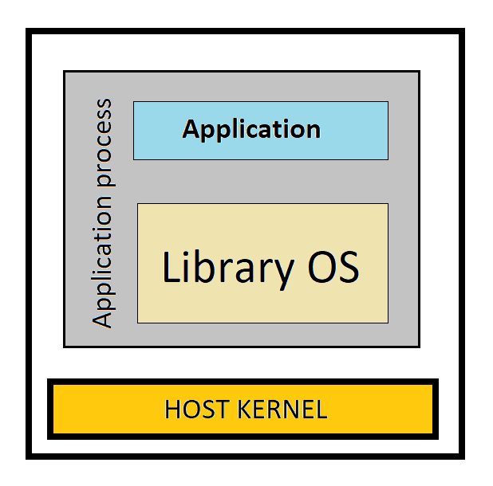
Drawbridge
Drawbridge packages application services into the library OS and leaves user and hardware services in the host OS
Each application runs in its own address space with its own copy of the library OS

Slide 8
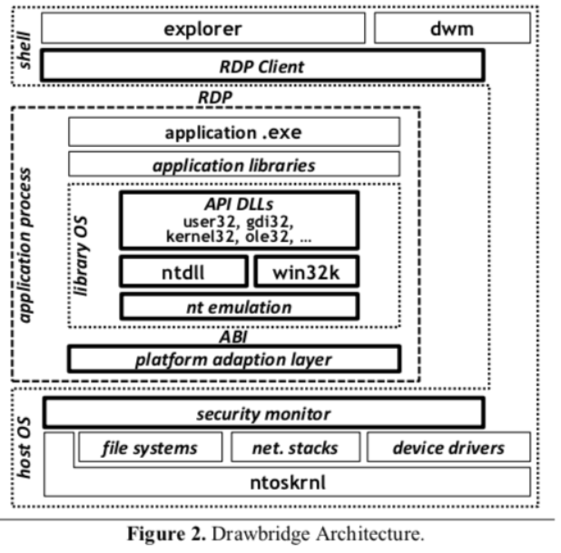
Drawbridge Architecture and Implementation
The library OS communicates with hardware services in the host OS through a narrow application binary interface (ABI), which is implemented by a platform adaptation layer and a security monitor.

Slide 9
Drawbridge Architecture and Implementation
The library OS communicates with user services in the host OS using the remote desktop protocol (RDP) ,tunneled through the ABI. Each application runs in its own address space with its own copy of the library OS

Slide 10
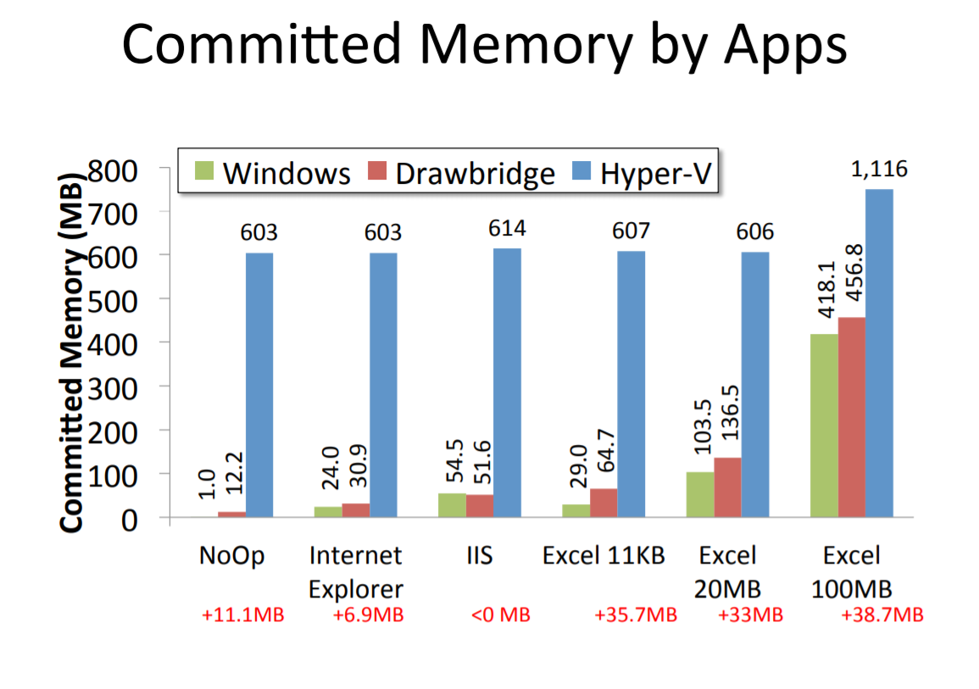
Results

Slide 11
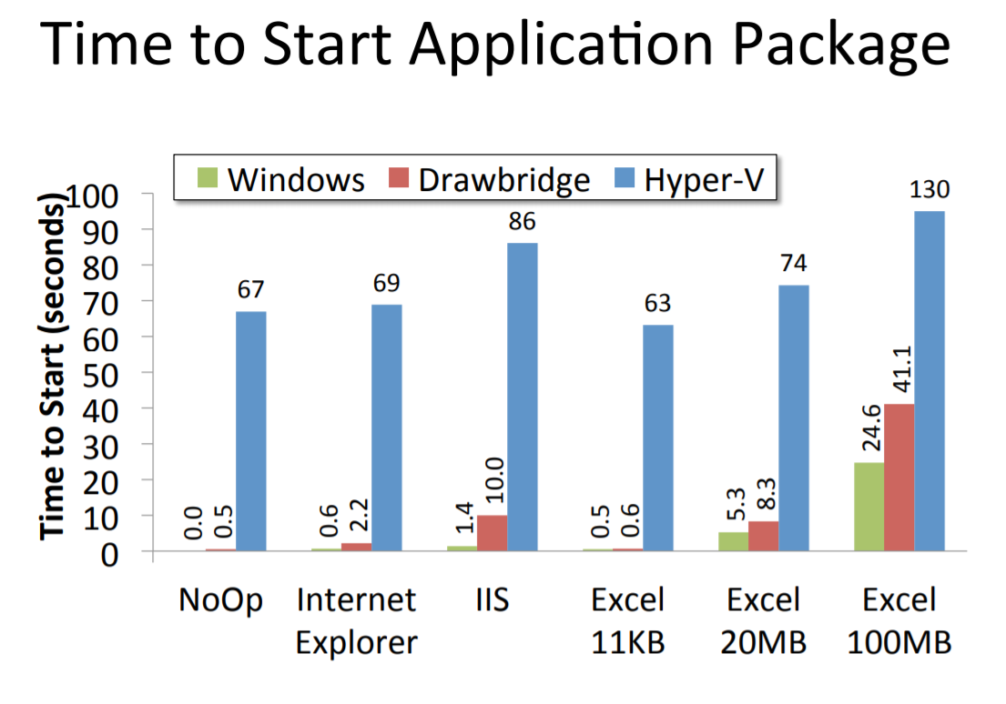
Results

Slide 12
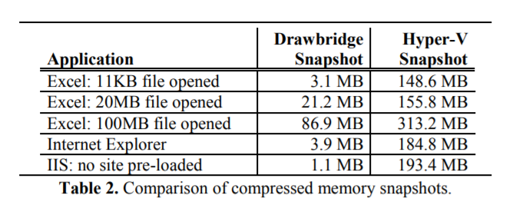
Results

Slide 13
Limitations
  Incomplete port of windows API
    Printer support
    Accelerated graphics
  Support for multi-process applications (e.g., Outlook with Word as an editor, sharing state through windows subsystem)
  Administrative tools will not work by design
    Need more low-level system access

Slide 14
Conclusion
The paper successfully demonstrates that we can use a refactored windows 7 OS as a library OS
It maintains the function benefits of a VM such as
  Robustness to change in the host system software
  Security isolation
  Migration
Comparing to a VM it has better scalability , causes lesser overhead and is much faster than a traditional virtual machine.

